Slide 1
Chapter 1
Computer Abstractions
and Technology

Slide 2
Topics
1.1 Introduction
1.2 Eight Great Ideas in Computer Architecture
1.3 Below Your Program
1.4 Under the covers
1.5 Technologies for building Processors and Memory
1.6 Performance
1.7 The Three Walls
1.8 Switch from Uniprocessors to Multiprocessors
1.9 Benchmarking the intel Core i7
1.10 fallacies and Pitfalls

Slide 3
1.1 Introduction

Slide 4
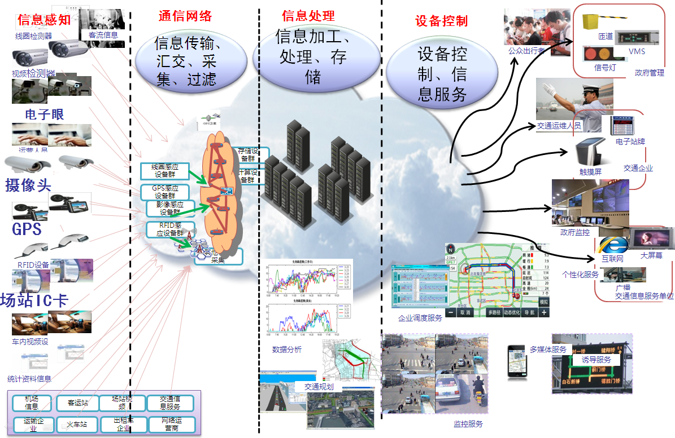
Computers are pervasive
Computers have led to a 3rd revolution for civilization

Slide 5
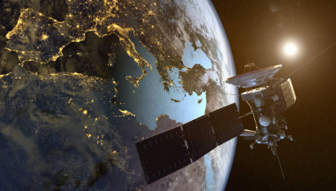
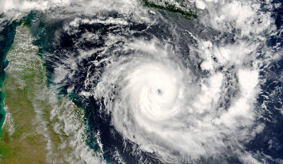

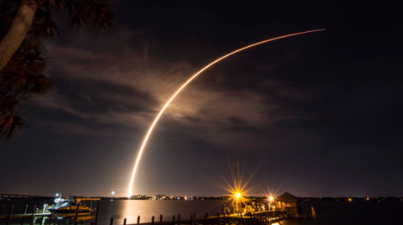
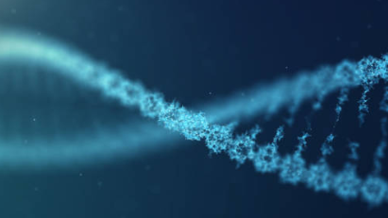
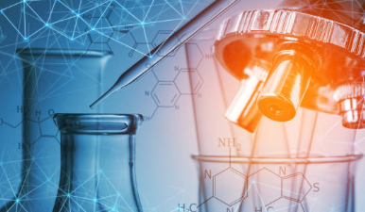
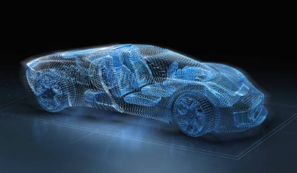
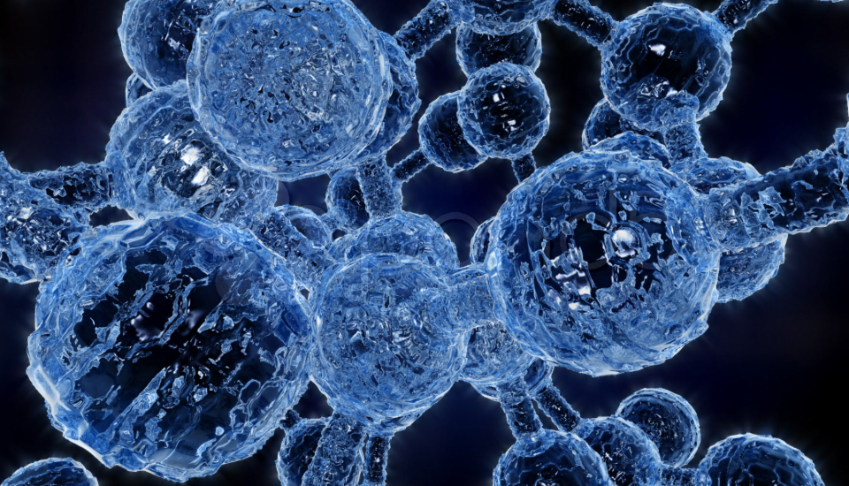
基于微处理器的HPC的典型应用场景
卫星测绘
气象科学
能源勘探
航空航天
生命科学
基础科学研究
汽车电子
分子动力学
Notes:
高性能计算是跨行业跨应用领域的计算学科，通常将最前沿的计算机技术用于最复杂、尖端的科学计算和求解，驱动着各行各业的技术进步。高性能计算广泛应用于超算中心、大学高校、科研机构、制造工程、地球物理、气象环境预测、油气勘探、生物分析、生命科学、天体物理、动漫渲染、能源及材料等各行业各领域。
高性能计算机在密集计算、海量数据处理等领域不可或缺，对于保障国防安全、促进科学研究及产业发展具有直接推动作用。在国防安全方面，核武器设计、核爆炸模拟、空气动力学、反导弹武器系统、空间技术的开发等需要在高性能计算机上进行模拟；在科学研究方面，长期气候预测、高精度天气预报、海洋环流计算、空气与水污染的模拟分析、洪水与地震等灾害的预报等都需要进行海量数据处理和大规模计算；在产业发展方面，发动机设计、模具设计、生物新药设计、风洞试验仿真、石油地质勘探以及新材料研究等都离不开高端计算。

Slide 6
Class of Computers
Classes | PC/Desktop | Server | Embedded | SuperComputers
Features | General purpose, variety of software Subject to cost/performance tradeoff | Network based High capacity, performance, reliability Range from small servers to building sized | Hidden as components of systems Stringent power/performance/cost constraints | High-end scientific and engineering calculations Highest capability but represent a small fraction of the overall computer market
Different design requirements
Employ the core hardware technologies in different ways
The basic principles are the same !

Slide 7
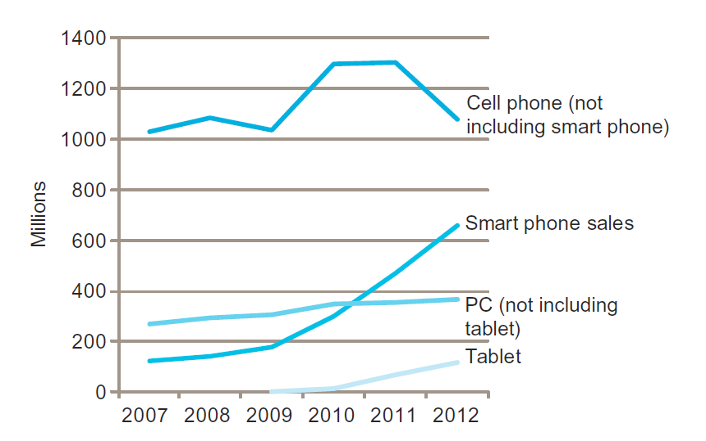
The PostPC Era
Personal Mobile Device (PMD)
Battery operated
Connects to the Internet
Hundreds of dollars
Smart phones, tablets, electronic glasses
Cloud computing
Warehouse Scale Computers (WSC)
Software as a Service (SaaS)
Portion of software run on a PMD and a portion run in the Cloud
Amazon and Google

Slide 8
Computer Generations
Pre-computer – ~ 1946
Non-electrical, non-programmable (非电子，不可编程)
First Generation – 1946 ~ 1956
Vacuum tubes, programmable (电子管，可编程，图灵完全)
Second Generation – 1956 ~ 1964
Transistor, programming languages (晶体管，编程语言开始应用)
Third Generation – 1964 ~ 1971
Integrated Circuit, OS (集成电路，操作系统开始应用)
Fourth Generation – 1971 ~ now
Microprocessor, GUI, Personal Computer (大规模集成微处理器, 图形用户界面, 个人电脑兴起)
Fifth Generation – future
Still in development … …

Slide 9
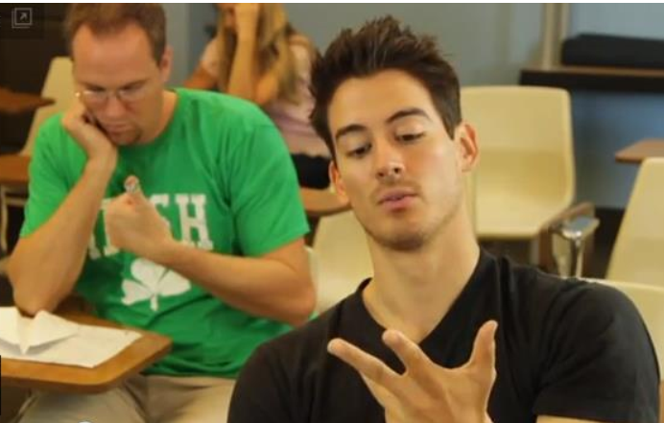
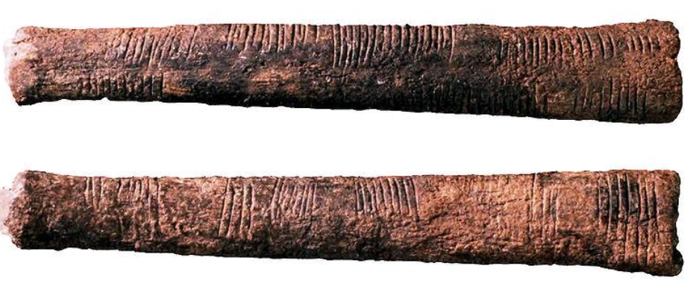
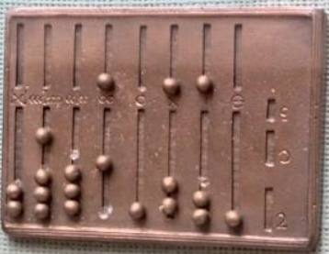
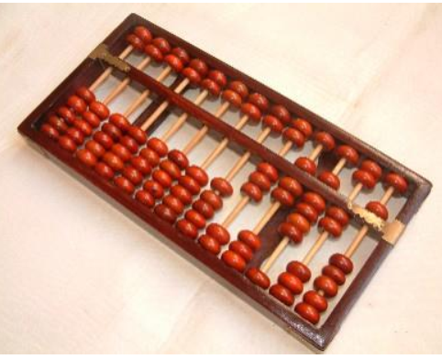
Pre-computers：计数的辅助工作
Digit: Latin for fingers
Tally sticks
Roman abacus
Asian abacus
Notes:
经考古研究表明：人类的计算是从计数开始．最早的计数工具从自身的双手开始到学会用小树枝、小木棍、小石子等工具进行计数。到了我国的唐代，人们发明了算盘，同时发明了一整套基于算盘的引算口诀，算盘应该是出现最早的较为成熟的计算工具，所以也有观点认为算盘可以看作是最早的计算机，而珠算口诀则是最早的算法。

Slide 10
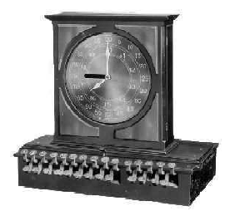
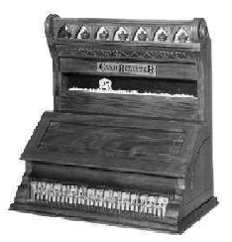
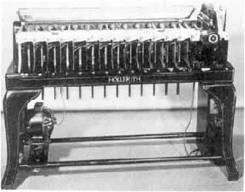
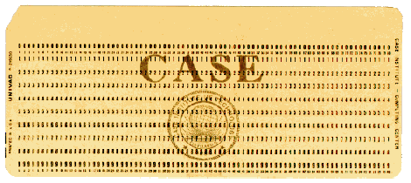
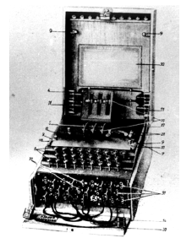
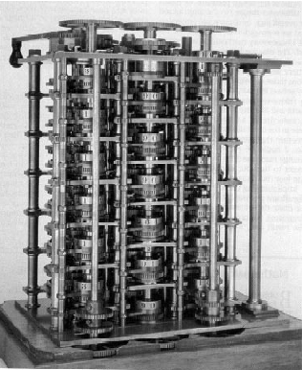
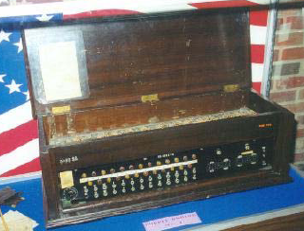
Pre-computer
Cash Register
Card sorter
Enigma Cipher machine
Babbage difference engine ( http://libai.math.ncu.edu.tw/bcc16/pool/3.01.shtml )

Slide 11
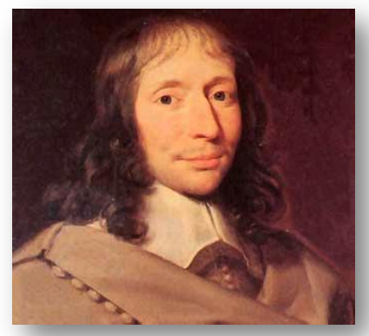
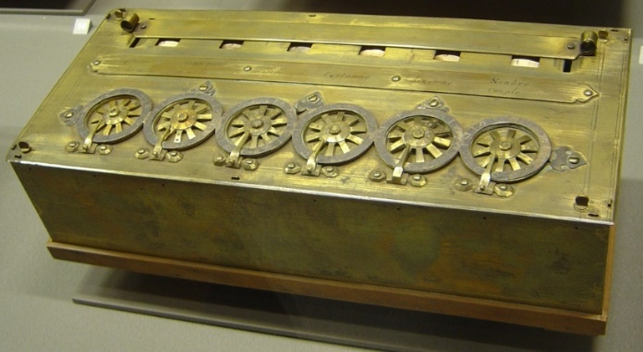
The First Mechanical Calculating Machine
The 17th century: the beginning of mechanical calculators
17世纪：机械式计数器开始出现
Pascaline (Pascal’s calculator)
Invented by Blaise Pascal in 1642-1645 (19-22岁！)
Addition and Subtraction: Two basic operations
两个基本操作：加与减
Multiplication and division: through repeated addition or subtraction
乘与除这两个操作通过重复地加或减间接实现
Blaise Pascal (1623-1662)
Pascal编程语言取名就是为了纪念Blaise Pascal
Pascaline (1645)
Notes:
17世纪法国科学家布莱斯•帕斯卡(B．Pascal)发明基于齿轮传动技术的机械式计算机。它的特点是利用人工手动作为计算机动力，利用齿轮、杠杆等机械装置来自动传送十进制数进行计算。随后的机电式计算机就是在机械式计算机的基础上用电力作动力，但计算原理仍然是机械式的。

Slide 12
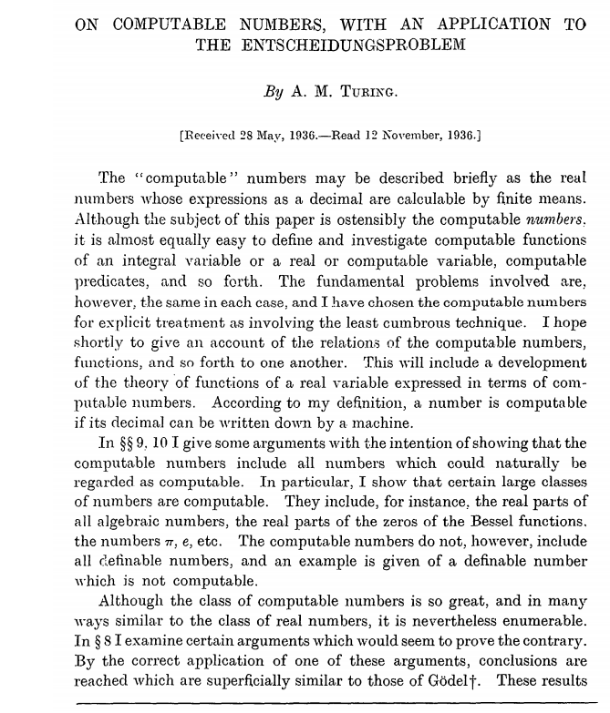
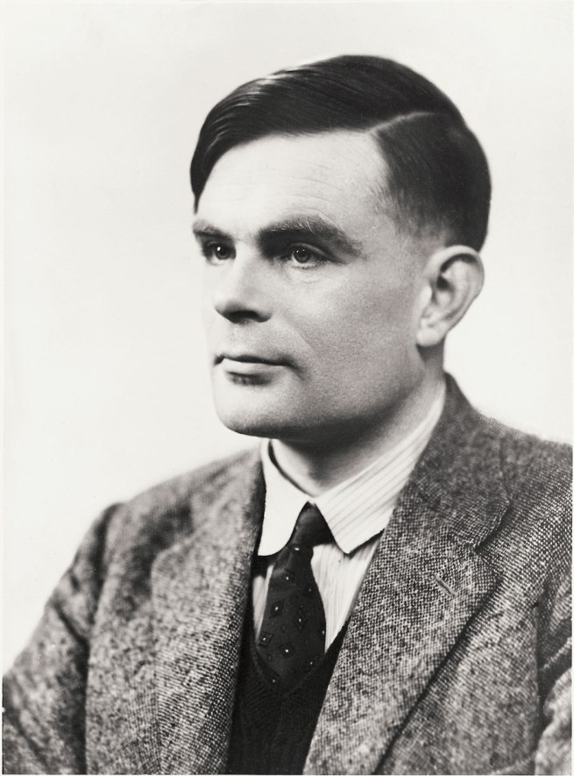
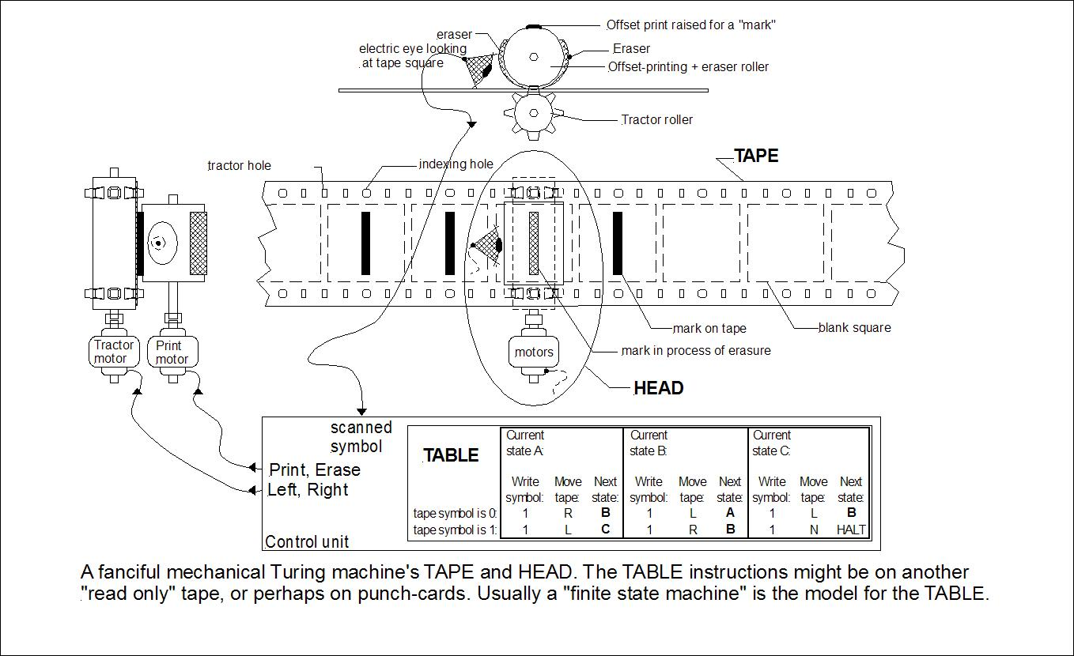
Turing Machine (1936)
Alan Turing described a theoretical device called the Turing machine, formalized the concepts of computation and algorithms in 1936
A.M.Turing (1912-1954)
Turing machine as a mechanical device
A.M. Turing (1936), On Computable Number
Notes:
阿兰·麦席森·图灵 Alan Mathison Turing ,是英国著名的数学家和逻辑学家,被称为计算机科学之父、人工智能之父,是计算机逻辑的奠基者,提出了“图灵机”和“图灵测试”等重要概念.人们为纪念其在计算机领域的卓越贡献而设立“图灵奖”.
1936年5月，图灵向伦敦权威的数学杂志投了一篇论文，题为《论数字计算在决断难题中的应用》。该文于1937年在《伦敦数学会文集》第42期上发表后，立即引起广泛的注意。在论文的附录里他描述了一种可以辅助数学研究的机器，后来被人称为“图灵机”，这个设想最有变革意义的地方在于，它第一次在纯数学的符号逻辑，和实体世界之间建立了联系，后来我们所熟知的电脑，以及还没有实现的“人工智能”，都基于这个设想。这是他人生第一篇重要论文，也是他的成名之作

Slide 13
Electromechanical Calculators
Early 20th century technology
Special-purpose system
Motor-driven mechanical calculators
Cache registers
Enigma cipher machine
Programmable systems
Punched-card sorters
Punched cards
Machines using relays to construct logic gates
Konrad Zuse’s Z3
Howard Aiken’s Mark-I(Harvard)

Slide 14
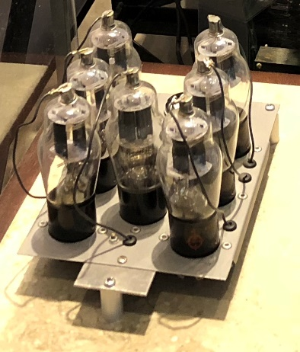
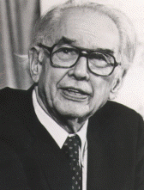
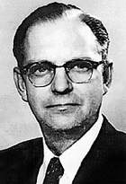
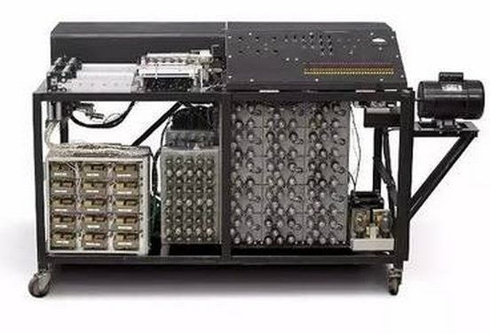
First electronic digital computing device
Atanasoff-Berry Computer(ABC) 1942
First electronic digit computing device 第一台纯电子的数字计算设备
Invented by Professor John Atanasoff and graduate student Clifford Berry at Iowa State College between 1939 and 1942
Special purpose. neither programmable, nor Turing-complete
非常接近现代计算机，但不可编程、非图灵完全
Add-subtract module
加减运算模块
对现代计算机发展的重要贡献
使用二进制数表示
用纯电子实现算术与逻辑运算
计算和存储分离
John Atanasoff (1903-1995)
Clifford Berry (1918-1963)
Atanasoff-Berry Computer (1942)
Notes:
阿塔纳索夫-贝瑞计算机（Atanasoff-Berry Computer，简称ABC）是法定的世界上第一台电子计算机，是爱荷华州立大学的约翰·文森特·阿塔纳索夫（John Vincent Atanasoff）和他的研究生克利福特·贝瑞（Clifford Berry）在1937年设计，不可编程，仅仅设计用于求解线性方程组，并在1942年成功进行了测试。而“埃尼阿克（ENIAC）”标志着计算机正式进入数字的时代。；
使用二进制数表示所有的数值和数据
使用电子器件进行所有计算操作，而不是滚轮、棘轮或者机械开关
计算和存储在系统中分离成两部分

Slide 15
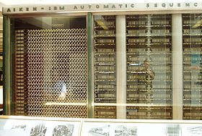
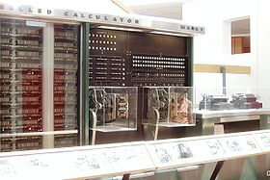
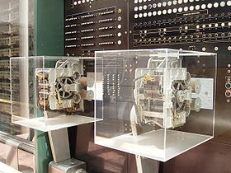
MarkI (Harvard) – IBM(ASCC) --1944 Automatic Sequence Controlled Calculator
“the beginning of the era of the modern computer” and "the real dawn of the computer age”.

Slide 16
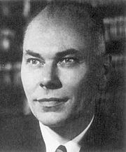
MarkI (Harvard) -- ASCC (IBM)
765,000 components and 500 miles (800 km) of wire with three million connections
volume of 51 feet (16 m) in length, eight feet (2.4 m) in height, and two feet (~61 cm) deep.
weight of about 10,000 pounds (4500 kg).
The basic calculating units had to be synchronized mechanically, so they were run by a 50-foot (~15.5 m) shaft driven by a five-horsepower (4 kW) electric motor
the industry's largest electromechanical calculator
Howard Hathaway Aiken

Slide 17
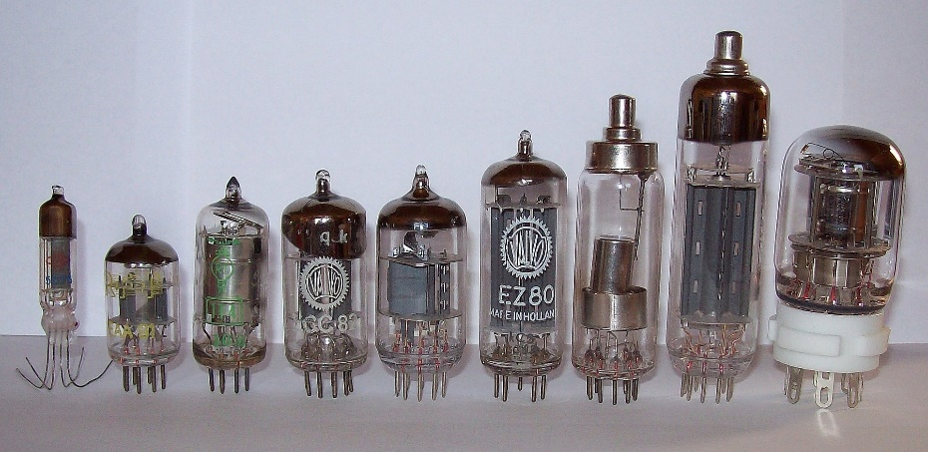
Electronic Computers --1st Generation （1946-1956）
Dominant technologies:
Processors: Vacuum tubles
Memory: Acoustic delay line, magnetic drum
Special-purpose system
John Atanasoff’s experimental machine
Colossus , ( decrypt the German Enigma cipher)
Hoffman’s computer (decrypt the Japanese Enigma cipher)
Programmable systems
ENIAC I-IV
Store-program systems
Experimental projects: EDVAC,
Commercial products: UNIVAC I, IBM701, 704(fp hardware)

Slide 18
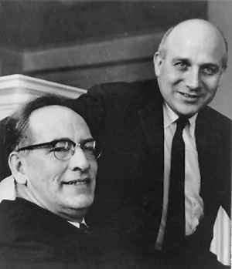
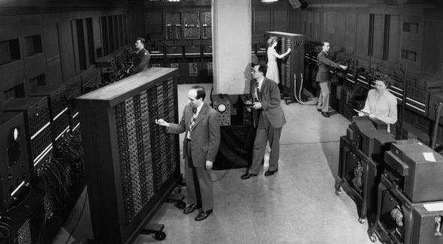
First general-purpose electronic digital computer
ENIAC (Electronic Numerical Integrator and Computer) in 1946
First general-purpose electronic computer 第一台通用电子计算机
Designed by John Mauchly and J. Presper Eckert of the University of Pennsylvania
General-purpose instruction set, decimal, programmable & Turing-complete
通用指令集、十进制、可编程、图灵完全
But NOT stored program 没有程序存储能力
Decimal (not binary)
20 accumulators of 10 digits
Programmed manually by switches
18,000 vacuum tubes
30 tons
15,000 square feet
140 kW power consumption
5,000 additions per second
ENIAC很多方面借鉴了1942年ABC计算机的设计
Notes:
1946年2月14日，世界上第一台电脑“埃尼阿克”ENIAC在美国宾夕法尼亚大学诞生。 第二次世界大战期间，美国军方要求宾州大学莫奇利（Mauchly）博士和他的学生埃克特（Eckert） 设计以真空管取代继电器的“电子化”电脑--ENIAC“埃尼阿克”（Electronic Numerical Integrator and Calculator）， 电子数字积分计算机）， 目的是用来计算炮弹弹道。
“埃尼阿克”长30.48米，宽1米，占地面积170平方米，30个操作台，约相当于10件普通房间的大小，重达30吨，耗电量150千瓦，造价48万美元。它使用18000个电子管，70000个电阻，10000个电容，1500个继电器，6000多个开关，每秒执行5000次加法或400次乘法，是继电器计算机的1000倍、手工计算的20万倍。

Slide 19

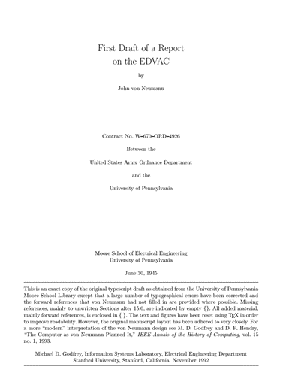
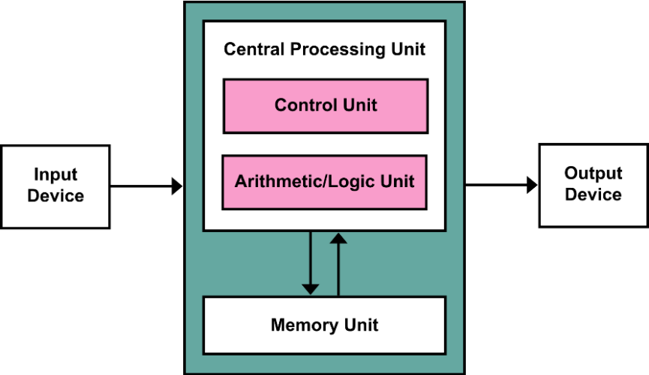
Von Neumann architecture (1945)
Stored Program concept
Main memory storing programs and data
ALU operating on binary data
Control unit interpreting instructions from memory and executing
Input and output equipment operated by control unit
Computation and memory are separated
计算与存储分离
Memory that stores data and instructions
数据与指令保存在同一个存储器
John von Neumann (1903-1957)
“First Draft of a Report on the EDVAC”
冯诺依曼提出体系结构的著名报告1945
Notes:
约翰·冯·诺依曼（ John von Neumann,1903－1957）,“现代电子计算机之父”,美籍匈牙利人,物理学家、数学家、发明家,“现代电子计算机之父”即电脑（即EDVAC,它是世界上第一台现代意义的通用计算机）的发明者.

Slide 20
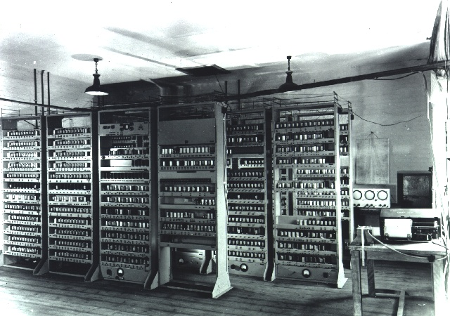
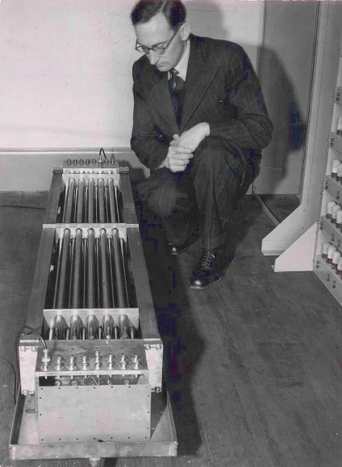
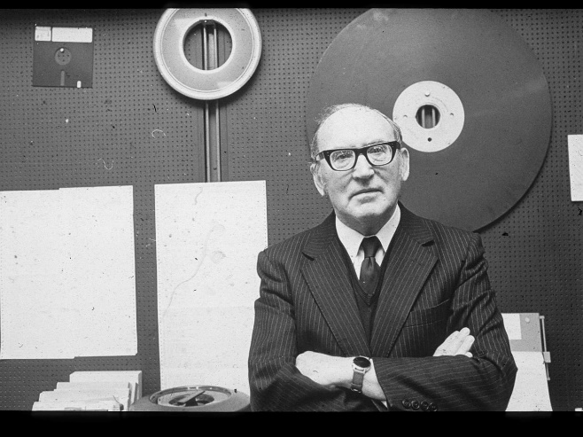
The first computer with stored-program
EDSAC：Electronic delay storage automatic calculator (1949)
Inspired by John von Neumann's seminal "first draft of a report on the EDVAC"
Constructed by Maurice Wilkes at the University of Cambridge Mathematical Lab.
Binary, stored-program (used a mercury delay line memory) 二进制、存储程序
Turing Award 1967
Maurice Wilkes (1913-2010)
mercury delay line memory

Slide 21
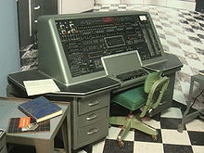
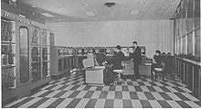
1st Commercial Computers
1947 - Eckert-Mauchly Computer Corporation
UNIVAC I (Universal Automatic Computer)
US Bureau of Census 1950 calculations
Became part of Sperry-Rand Corporation
Late 1950s - UNIVAC II
Faster
More memory

Slide 22
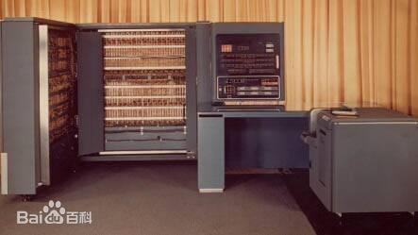
IBM
Punched-card processing equipment
1952.4 - the 701
IBM’s first stored program computer
Scientific calculations
First mass-produced mainframe
1955 - the 702
Business applications
Lead to 700/7000 series

Slide 23
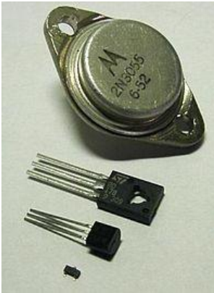
Electronic Computers -- 2nd Generation (1956-1964)
Dominant technologies
Processors: Discrete transistors
Smaller, faster, less power, more reliable
Memory: Magnetic cores
Programming: binary machine language
➔symbolic languages
I/O: Punched cards for input/output.
Examples:
UNIVAC III, RCA 501, Philco TransactS-2000,
NCR 300 series, IBM7030 Stretch
General-purpose computers
IBM System/360
Minicomputers: Digital Equipment PDP-8
Supercomputers
Control Data 6600
Innovations: Load-store architecture, pipeline

Slide 24
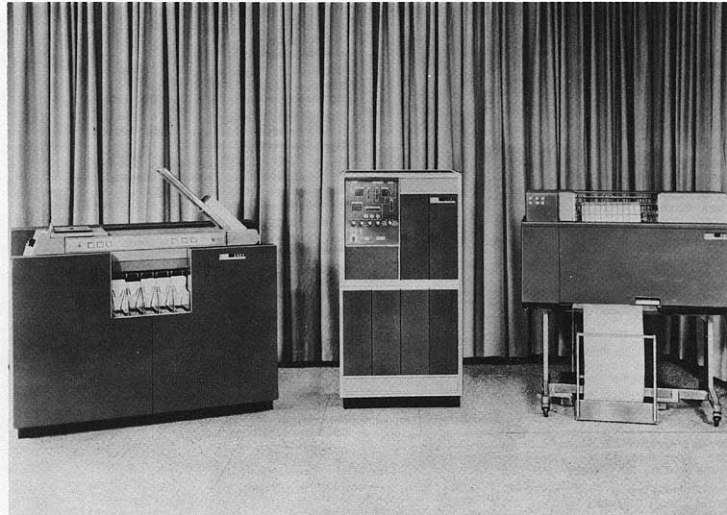
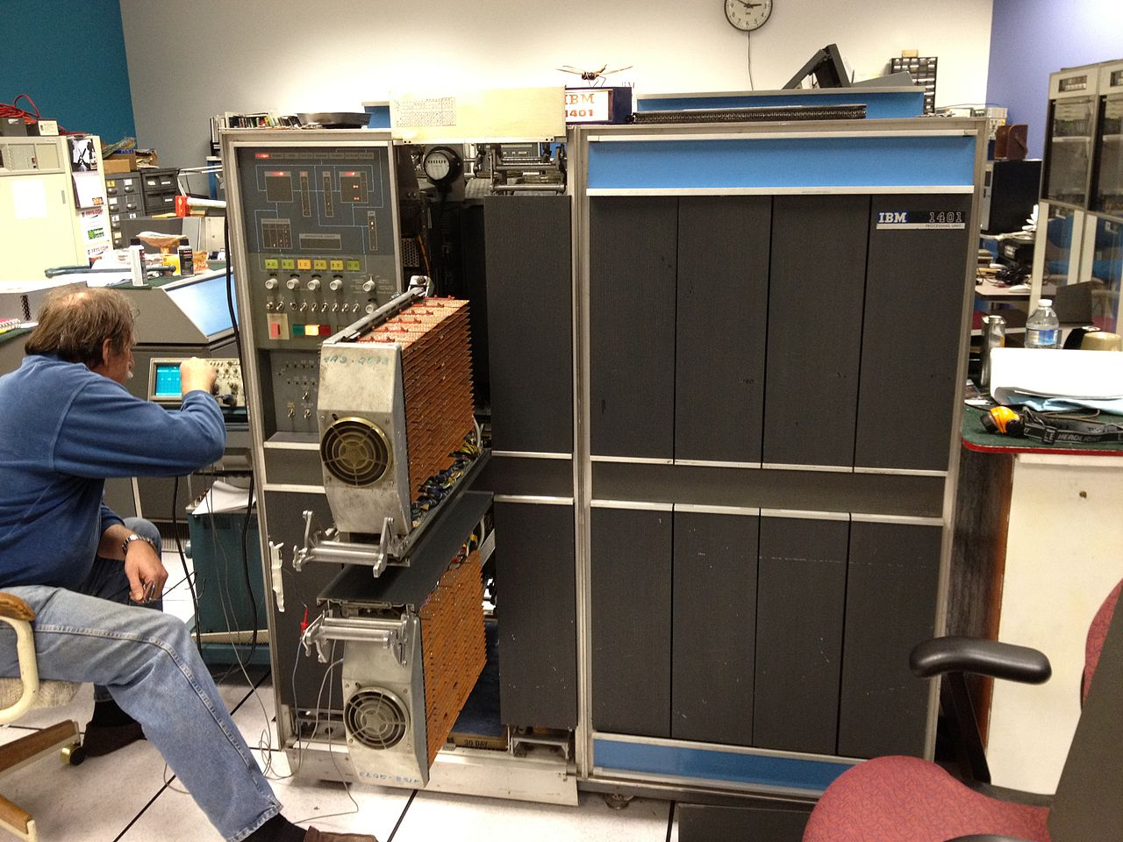
IBM 1401 (1959)
announced by IBM on October 5, 1959.
a variable-wordlength decimal computer (可变字长、十进制)
installed more than 10,000 units between 1960 and 1964. 商业上大获成功
1401 Processing Unit
1402 Card Read-Punch
1403 Printer
IBM 1401 system
IBM 1401
Notes:
1951年：UNIVAC-1 ——第一台商用计算机系统诞生，设计者是J.Presper Eckert和John Mauchly。被美国人口普查部门用于人口普查，标志着计算机进入了商业应用时代; UNIVAC-III 采用Tranisitor； UNIVAC-III；

Slide 25
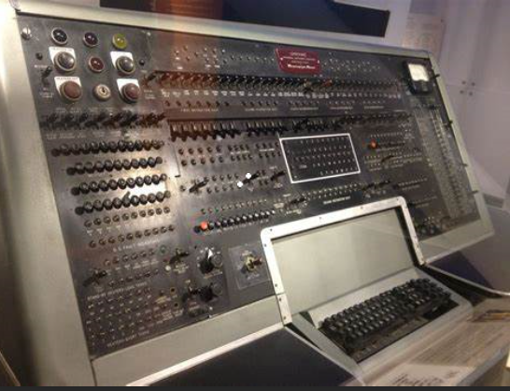
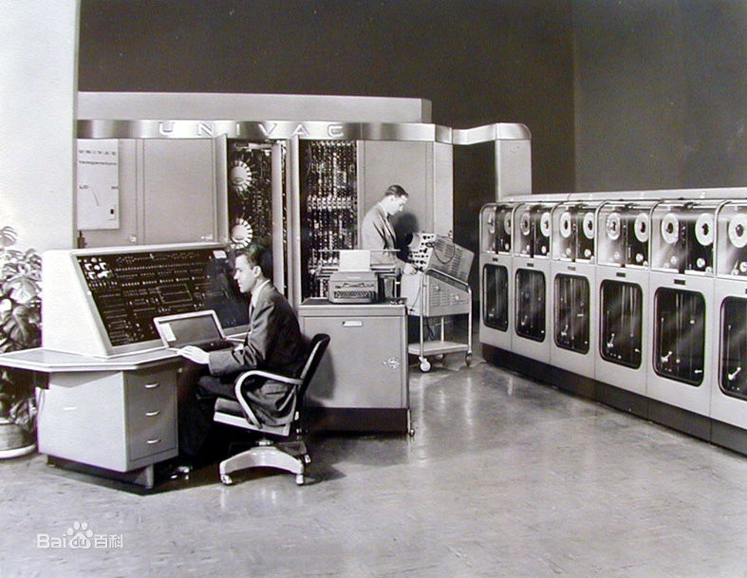
UNIVAC III (1962)
UNIVersal Automatic Computer III (1962)
Designed by John Perper Eckert and John Mauchly (ENIAC designers)
An improved transistorized replacement for UNIVAC I and UNIVAC II
Notes:
1951年：UNIVAC-1 ——第一台商用计算机系统诞生，设计者是J.Presper Eckert和John Mauchly。被美国人口普查部门用于人口普查，标志着计算机进入了商业应用时代; UNIVAC-III 采用Tranisitor； UNIVAC-III；

Slide 26
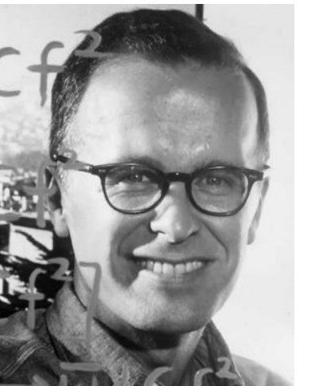

高级编程语言出现：FORTRAN (1957)
The first widely-used high-level programming language
第一个广泛使用的高级编程语言
Turing Award 1977
John Backus
developed FORTRAN in 1957 for the IBM 704 computer
inventor of the Backus–Naur form (BNF)
National Medal of Science in 1975
John Backus (1924-2007)
IBM 704 computer
Notes:
高级编程语言 FORTRA 也是在第二代计算机的这个时候开始发展

Slide 27




Electronic Computers -- 3rd Generation (1964-1971)
Dominant technologies:
Processors: Integrated circuits
Memory:
Early: Magnetic cores
Later: Integrated circuits(SRAM, DRAM)
OS: run many different applications at one time
General-purpose computers
Minicomputers: PDP-11, VAX11-780
IBM system/360
Supercomputer s
Control Data 7600
Cray-1

Slide 28


IBM System/360 Family (1964)
Announced in 1964, delivered in 1965
Model 30: up to 34,500 instructions per second, with memory from 8 to 64 KB.
Model 91 in 1967: up to 16.6 million instructions per second, with memory from 1M to 4M
Extremely successful in the market 商业上极为成功
Gene Amdahl (1922-2015)
First planned “family”
Similar or identical instruction sets
Similar or identical O/S
Increasing speed
Increasing number of I/O ports
(i.e. more terminals)
Increased memory size
Increased cost
Backward compatibility 向前兼容
Computer System Architecture Specification
Chief Architect: Gene Amdahl (NAE in 1967)
A Single Operating System for All: OS/360
Dynamic address translation (virtual memory) 虚拟内存
Time-sharing 分时
Tape drive
Mainframe
Disk drive
IBM System/360 Model 30

Slide 29




IBM Compatibility Problem in Early 1960s
By early 1960’s, IBM had 4 incompatible lines of computers !
701 → 7094
650 → 7074
702 → 7080
1401 → 7010
Each system has its own
Instruction set architecture
I/O system and secondary storage
Assemblers, compilers, libraries, …
Market niche: business, scientific, real time, …

Slide 30

DEC PDP-8
1964
First minicomputer (after miniskirt!)
Did not need air conditioned room
Small enough to sit on a lab bench
$16,000
$100k+ for IBM 360
Embedded applications & OEM
BUS STRUCTURE

Slide 31



UNIX (1960s) & C programming language (1972)
Ken Thompson & Dennis Ritchie at Bell Labs
Designed and implemented Unix OS in 1960s
Thompson invented B programming language
Ritchie invented C programming language in 1972-1973
Turing Award 1983
UNIX又孵育了Linux，及安卓Android
Ken Thompson (1943-)
Dennis M. Ritchie (1941-2011)
Ritchie & Thompson
at a PDP-11
DEC PDP-7
as used for initial work on Unix
Notes:
高级编程语言 FORTRA 也是在第二代计算机的这个时候开始发展

Slide 32



Pascal programming language (1970)
Niklaus Wirth (Turing Award 1984 )
designer of the programming languages Euler, Algol W, Pascal, Modula, Oberon
Pascal programming language: 1970.
提出：Algorithms + Data Structures = Programs
Pascal语言的论文(1970)
《Algorithms + Data Structures = Programs》
1976
Niklaus Wirth (1934- ) 瑞士

Slide 33


Electronic Computers -- 4th Generation (1971- )
Dominant technologies
Processors:
Custom LSI or VLSI modules on PC board
Memory: SRAM, DRAM
Microprocessor: : Texas Instruments, Intel, and Garrett AiResearch
General-purpose computers
IBM 3xxx, 43xx series
Minicomputers: VAX8400
Minisupercomputers:
Convex C-1, C-2, C-3
Vector supercomputers
Cray-2, Cray X-MP, Cray Y-MP
Fujitsu, Hitachi, NEC

Slide 34




Computer Mouse (1968)
光标
NLS system (or “oN-Line System”) 1960s
A revolutionary computer collaboration system developed in the 1960s.
Designed by Douglas Engelbart
Publicly demonstrated at the AFIP Fall Joint Conference in 1968
鼠
标
Turing Award 1997
Main features
The mouse
Multiple windows
hypermedia
modern word processing
shared files
electronic messaging
shared displays with multiple pointers
audio/video conferencing
ideas of an Internet
1968年大会演示：用鼠标进行文档编辑
Douglas Engelbart (1925-2013)

Slide 35




Dynabook vision (1972)
Dynabook
In 1972 Alay Kay’s article “A personal computer for children of all ages”
Conceptual vision of a laptop/tablet computer.
提出了便携电脑与平板电脑的原型设计
Turing Award 2003
Alan Kay (1940- )
Also:
Smalltalk面向对象程序设计思想提出者
overlapping windowing GUI提出者
Notes:
Dynabook in his 1972 proposal "A personal computer for children of all ages",^{[1]} outlines the requirements for a conceptual portable educational device that would offer similar functionality to that now supplied via a laptop computer or (in some of its other incarnations) a tablet or slate computer

Slide 36




The first modern personal computer (首台现代个人电脑)
Xerox Alto in 1973 at Xerox PARC
designed mostly by Charles P. Thacker
Mouse-driven Graphical User Interface
Alto Mouse
Turing Award 2009
Charles Thacker (1943-2017)
Xerox Alto (1973)
Xerox Star (1981)

Slide 37



Commercial Personal Computer
IBM PC：with an Intel CPU & Microsoft’s DOS in 1981
Price started at $1,565
300,000 sold in 1981
3,274,000 sold in 1982
Apple (Steve Jobs) developed Macintosh OS with GUI in 1984
Microsoft (Bill Gates) released Windows 1.0 in 1985, the first version.
TIME named in 1982
Machine of the year

Slide 38



RISC Architecture (1980s) ：更高的性能
RISC (Reduced Instruction Set Computer): a computer instruction set
fewer cycles per instruction (CPI) than a Complex Instruction Set Computer (CISC).
指令执行用尽量少的时钟周期、指令编码长度定长等 → 提高CPU与编译效率
Now used in 99% of new computer chips, e.g. smartphones
现在绝大部分芯片已采用RISC架构，如ARM芯片、智能手机
Turing Award 1987
Turing Award 2017
Turing Award 2017
1975-1980: IBM 801
The 1st RISC system
→ IBM PowerPC
spent his entire career as an industrial researcher for IBM in1956-1992.
MIPS project of a Stanford graduate course in 1981
→ found MIPS company in 1985
President of Stanford Univ. (2000-2016)
Chairman of Alphabet
Berkeley RISC project from 1980
→ commercialized as the SPARC.
one of the innovators of RAID in 1989-1993
John Cocke (1925-2002)
John L. Hennessy (1952-)
David Patterson (1947-)

Slide 39
RISC
Dominant technologies
Processors: Mass-produced microprocessors
Memroy: SRAM, DRAM
Compiler optimization
RISC processors
MIPS (Silicon Graphics)
PA-RISC (Hewlett Packard)
SPARC ( Sun Microsystems)
Alpha ( Digital Equipment)
PowerPC( Apple, Motorala, IBM)
Motorala 88000
I860, i960 (Intel)
CISC processors:
80x86, Pentium, Penium Pro, Pentium II & III (Intel)

Slide 40
Speeding it up
Pipelining
On board cache
On board L1 & L2 cache
Out Of Order execution
Branch prediction
Data flow analysis
Speculative execution
Multiple issue: Superscaler, VLIW

Slide 41




The 5th Generation？
Quantum Computer 量子计算机
Wearable Computer 穿戴计算机
Neuromorphic Computer 类脑计算机
Intelligence Computer 人智计算机

Slide 42
What is a computer？
Computer is an electronic device that manipulates data according to a list of instructions (program), with capability of Turing machine.
Electronic realization 电子化的实现方式
A set of instructions in a well-defined manner 有指令集 → general-purpose
Execution of a pre-recorded list of instructions 可执行指令 → program-controlled
Memory that can store instructions and data 可存储指令与数据 → stored program
Turing-complete in theory 计算能力上是图灵完全 → equivalent to Turing machine

Slide 43
What lessons we learned from the history ?
Technological improvements more steady than progress in computer architecture, greatly promotes the improvement of computer performance
After RISC emergence, computer design emphasized both architectural innovation and efficient use of technology improvements.
Software advances can inspire architecture innovations
Raising the hardware/software interface creates opportunities for architecture innovation
Ultimately the marketplace settles architecture debates

Slide 44
1.2 Eight Great Ideas in Computer Architecture

Slide 45
Eight Great Ideas
Design for Moore’s Law （设计紧跟摩尔定律）
Use Abstraction to Simplify Design (采用抽象简化设计)
Make the Common Case Fast (加速大概率事件)
Performance via Parallelism (通过并行提高性能)
Performance via Pipelining (通过流水线提高性能)
Performance via Prediction (通过预测提高性能)
Hierarchy of Memories (存储器层次结构)
Dependability via Redundancy (通过冗余提高可靠性)

Slide 46

Idea1：Design for Moore’s law
Increased density of components on chip
Number of transistors on a chip will double every year
Since 1970’s development has slowed a little
Number of transistors doubles every 18 months
Cost of a chip has remained almost unchanged
Higher packing density means shorter electrical paths, giving higher performance
Smaller size gives increased flexibility
Reduced power and cooling requirements
Fewer interconnections increases reliability

Slide 47

Idea1：Design for Moore’s law
One constant for computer designer is rapid change.
Design for where it will be when finishes rather than design for where it starts.
Gordon Moore, a cofounder of Intel, predicts that the number of transistors which can be placed on a single chip will double every 2 year. It has held steady and was dubbed “Moore’s Law” around 1970
Why Moore’s law?
Smaller Transistor, more function on same chip area;
Smaller Transistor, low power
Smaller Transistor, smaller area for same function, low cost;
Notes:
在高性能芯片，特别是处理器的设计中，如果没有紧跟摩尔定律的企业就会被淘汰。

Slide 48
Pitfall
Ignoring the inexorable progress of hardware when planning a new machine.
Example
The machine introduce in three years will be a terrific seller because it’s three times as fast as anything available today.
Machine x will be 1.5³x = 3.4x

Slide 49


Idea2: Use abstraction to simplify design
Lower-level details are hidden to offer a simple model at higher level
Notes:
在考虑通俗易懂的例子。

Slide 50


Eight Great Ideas --3 in Computer Architecture
Make the common case fast
Common case is often simple
vs

Slide 51
Idea3：Make the common case fast
Making the common case fast will tend to enhance performance better than optimizing the rare case
for(i=0;i<2;i++){
洗衣半小时
}
for(i=0;i<1000;i++){
上班走路1小时
}
for(i=0;i<2;i++){
做饭半小时
}
I think I should buy a car first.
Notes:
Principle 1

Slide 52

Pitfall on Performance
Expecting the improvement of one aspect of a computer to increase overall performance by an amount proportional to the size of the improvement.
Example

Slide 53

Amdahl’s law
Amdahl's law defines the speedup
If we know two factors:
Fraction enhanced : Fraction of computation time in original machine that can be converted to take advantage of the enhancement.
Speedup enhanced in enhanced mode : Improvement gained by enhanced execution mode:

Slide 54


Idea4:Performance via parallelism
Get more performance by performing operation in parallel

Slide 55



Idea5: Performance via pipelining
A, B, C, D all have some clothes to wash, dryer and fold
Wash: 30minuts
Total time ?
Dryer: 40minuts
(30+40+20)x4 = 360
Fold: 20minuts
Notes:
四抱衣服总的时间: (30+40+20)x4 = 360

Slide 56

Idea5 :Performance via pipelining
Extra Cost？
30+40*4+20=210
Notes:
Extra：B的洗衣服的步骤也变成40分钟，因为需要等待烘干器烘干，导致洗衣机有10分钟浪费； 所以流水线最好的状态的每一个步骤时间都一样；

Slide 57

Idea6 :Performance via prediction
To guess and start working rather than waiting until you know for sure
The mechanism to recover from a misprediction is not too expensive and prediction is relatively accurate
Notes:
飞碟射击

Slide 58
Idea7 :Hierarchy of memories
Hierarchy of Memory
Upper Level
Staging
Xfer Unit
Size / speed
faster
1000B/300ps
64KB/1ns
256KB/3-10ns
2-4MB/10-20ns
4-16GB/50-100ns
4-16TB/5-10ms
Registers
Instr. Operands
prog./compiler
1-8 bytes
Cache
Blocks
cache cntl
8-128 bytes
Memory
Pages
OS
512-4K bytes
Disk
Files
user/operator
Mbytes
Larger
Tape
Lower Level

Slide 59

Idea8: Dependability via redundancy
Not only be fast, also to be dependable.
Any physical device can fail.
Make systems dependable by including redundant components that can take over when a failure occurs and to help detect failures
Notes:
大货车采用双排轮胎

Slide 60

Idea8: Dependability via redundancy
Dependability via Redundancy

Slide 61

1.3 Below your program computer Software system

Slide 62
Computer organization
Decomposability of computer systems
Application software(应用软件): word, PPT, office
Software
Operation system：Linux, macos
System software
Compiler(编译器)：GCC
Computer System
Firmware(Driver software):例如：网卡驱动
Hardware
Notes:
首先介绍Hardware ， 这里对Hardware进行展开；

Slide 63

Software categorization
Categorize software by its use
Systems software ---- aimed at programmers
Applications software ---- aimed at users
Operating system
Handing basic input and output operations
Allocating storage and memory
Sharing the computer among multiple applications using it simultaneously
Compiler: Translation of a program written in HLL(高级编程语言)
Firmware(驱动): Software specially designed for a piece of hardware

Slide 64
Levels of program code
High-level programming language(高级编程语言)
Notations more closer to the natural language ex. A + B
The compiler translates into assembly language
Advantages over assembly language
Think in a more natural language
Programs can be independent of hardware
Assembly language(汇编语言)
Symbolic notations ex. add A, B
The assembler translates them into machine instruction
Machine language(机器语言)
Computers only understands electrical signalson/off
Binary numbers express machine instructions
ex. 1000110010100000 means to add two numbers

Slide 65
The HW/SW Interface
Application software
a[i] = b[i] + c;
Compiler
lw $15, 0($2)
add $16, $15, $14
add $17, $15, $13
lw $18, 0($12)
lw $19, 0($17)
add $20, $18, $19
sw $20, 0($16)
Systems software
(OS, compiler)
Assembler
Hardware
000000101100000
110100000100010
…

Slide 66

From a High-Level Language to the Language of Hardware
Lower-level details are hidden to higher levels
Instruction set architecture（指令集） ---- the interface between hardware and lowest-level software
Many implementations of varying cost and performance can run identical software
Notes:
指令集将处理器的硬件抽象化(Abstraction); 核心；

Slide 67
Program execution
Interpreter
Source
Code
Basic
ASP
JS
Editor
Java
编
译
Compile
Byte
Code
C、C++
Pascal
Fortran
Object
model
interpreter
Static
Libary
Link
Dynamic
Link Libary
Run
Executable
File
Excute

Slide 68
Start a C program in a file on disk to run 1
Compiling
C program → assembly language program
Assembling
Assembly language program → machine language module
Linking
Object modules (including library routine) → executable program
6 pieces of the object file for Unix systems:
object file header
text segment
data segment
relocation information
symbol table
debugging information
Place code and data modules symbolically in memory
Determine the addresses of data and instruction labels
Patch both the internal and external references

Slide 69
Start a C program in a file on disk to run 2
Loading
Determine size of text and data segments
Create an address space large enough
Copy instructions and data from executable file to memory
Copy parameters (if any) to the main program onto the stack
Initialize registers and set $sp to the first free location
Jump to a start-up routine

Slide 70
A translation hierarchy

Slide 71
MIPS memory allocation for program and data
Access data by
$gp +/- offset(16bit)
10000000x
~ 1000FFFFx
Notes:
静态数据：那些不随时间或其它数据变化而变化的数据.其中又可分为结构参数和功能参数.
动态数据：

Slide 72

1.4 Under the covers computer hardware system

Slide 73

Touchscreen
PostPC device
Supersedes keyboard and mouse
Resistive and Capacitive types
Most tablets, smart phones use capacitive
Capacitive allows multiple touches simultaneously

Slide 74

Through the Looking Glass
LCD screen: picture elements (pixels)
Mirrors content of frame buffer memory

Slide 75
Computer organization
Decomposability of computer systems
Software
Control unit
Path: multiplexors
ALU: adder, multiplier
Registers
……
CPU
Computer System
Datapath
Hardware
Memory
Input: keyboard
I/O interface
Bidirectional: RS-232,USB
Output: VGA，LCD
Notes:
首先介绍Hardware ， 这里对Hardware进行展开；

Slide 76

Von Neumann’s Architecture

Slide 77

Five classic components of hardware
CPU: process data
I/O: input data
Memory: store program
I/O: output data
Memory: store data
Notes:
此图围绕数据展开：input ,output ,process, store, 说明hardware的5个关键；
I/O三种类型， input， output，双向；
Memory 两种类型，程序存储和数据存储；
CPU：处理数据；

Slide 78



Opening the Box
Components of Apple iPad
Logical Board (main board:主板)
Integrated Circuit on it
Central Processor Unit (CPU)

Slide 79
I/O Interfaces
I/O dominates this device.
Input device: A mechanism through which the computer is fed information
Multitouch LCD(触摸屏)
Front/near facing camera(前置摄像头)
Microphone, headphone(麦克风)
Gyroscope(陀螺仪)
WIFI, Bluetooth(蓝牙)
Output device: A mechanism that conveys the result of a computer to a user, such as a displayer, or to another computer
Speaker(扬声器)
Multitouch LCD
WIFI, Buluetooth
Multitouch LCD
Front/near facing camera
Microphone
WIFI, Bluetooth
Logical Board
Components of Apple iPad
Notes:
拆解；找一张彩照， 能够在涂上标注出这些， 一个框，加箭头， 然后这些器件； IPAD 任何都可以

Slide 80
Logical board(主板)
Composed of integrated circuits:
CPU(Apple A5): Dual ARM processor, 1GHZ, 512MB DDR inside package.
Flash(闪存): 32GB Flash.
Power controller: start up(启动), shutdown(关机), standby(待机)
I/O controller: e.g. Control Touchscreen , control microphone
Composed of integrated circuits (chips：集成电路，芯片): A device combining dozens of millions of transistors.
Flash
Flash
CPU
Power
Controller
Power
Controller
I/O Controller
Notes:
Logical board 均为Integrated circuit;
主要的集成电路是： CPU(A5), Memory，分别介绍CPU和Memory的功能；
这页主要介绍CPU， 并引出集成电路；

Slide 81
CPU (Processor)
CPU(Processor): active part of the computer, which contains the datapath and control and which adds numbers, tests numbers, signals I/O devices to activate, and so on.
Datapath (数据通路): performs arithmetic operation
Control (控制通路): commands the datapath, memory, and I/O devices according to the instructions of the program

Slide 82

华为Tianshan 服务器内部视图
电源
内存
CPU
硬盘
风扇
PCIe 扩展插槽
Notes:
CPU
CPU是Central Processing Unit的缩写，即中央处理器。由控制器，运算器，寄存器和内部总线构成，是整个计算机系统中最重要的部分。
内存
内存是介于CPU 和外部存储之间，是CPU 对外部存储中程序与数据进行高速运算时存放程序指令、数据和中间结果的临时场所，它的物理实质就是一组具备数据输入输出和数据存储功能的高速集成电路。
硬盘
服务器上使用的硬盘，有区别于普通硬盘。目前服务器市场上采用的硬盘主要有三种，SATA硬盘、SCSI硬盘以及SAS硬盘。如果说服务器是网络数据的核心，那么服务器硬盘就是这个核心的数据仓库，所有的软件和用户数据都存储在这里。
电源
服务器电源和个人电脑电源一样，都是一种开关电源。服务器电源按照标准可以分为ATX电源和SSI电源两种。ATX标准使用较为普遍，主要用于台式机、工作站和低端服务器；而SSI标准是随着服务器技术的发展而产生的，适用于各种其他档次的服务器。
网卡
又称网络适配器或网络接口卡（NIC），英文名为Network Interface Card。适用于服务器与交换机等网络设备之间的连接。

Slide 83

华为TaiShan 服务器物理结构
TaiShan 200服务器（型号2280）
1 | IO模组1 | 2 | IO模组2
3 | 电源模块 | 4 | 机箱
5 | IO模组3 | 6 | 超级电容支架
7 | 导风罩 | 8 | 前置硬盘背板
9 | 风扇支架 | 10 | 风扇模块
11 | 前置硬盘 | 12 | 理线架
13 | 散热器 | 14 | DIMM
15 | 主板 | 16 | RAID扣卡
17 | 灵活IO卡1（CPU 1） | 18 | iBMC插卡
19 | 灵活IO卡2（CPU 2） | - | -

Slide 84
Memory: A safe place for data
Memory(存储): the storage area programs are kept and that contains the data needed by the running programs
Main Memory(主存): volatile; used to hold programs while they are running.( DRAM in computers)
Second memory: nonvolatile; used to store programs and data between runs. (Flash in PMD, magnetic disks)
Volatile (易失性)
DRAM (Dynamic Random-Access Memory):动态随机存储器
SRAM (Static Random Access Memory)：静态随机存储器
Nonvolatile (非易失性)
Solid state memory (Flash Memory):固态硬盘 or 闪存
Magnetic disk (Hard disk) ：硬盘
Memory |  | Price | Speed | Capacity | Used for
SRAM | volatile | / | Fastest | KB~MB | Cache
DRAM | volatile | $3~4/GB | Fast | MB~GB | Main memory
Hard disk | nonvolatile | $0.05~1/GB | Slow | TB~PB | PC Storage
Flash Memory | nonvolatile | $0.75~$1/GB | Medium | GB~TB | PMD Storage

Slide 85




A Safe Place for Data
Volatile main memory
Loses instructions and data when power off
Non-volatile secondary memory
Magnetic disk
Flash memory
Optical disk (CDROM, DVD)

Slide 86


Networks
Communication, resource sharing, nonlocal access
Local area network (LAN): Ethernet
Wide area network (WAN): the Internet
Wireless network: WiFi, Bluetooth

Slide 87
Abstractions
The BIG Picture
Abstraction helps us deal with complexity
Hide lower-level detail
Instruction set architecture (ISA)
The hardware/software interface
Application binary interface
The ISA plus system software interface
Implementation
The details underlying and interface

Slide 88

1.5 Technologies for building Processors and memory

Slide 89
Integrated circuits
Integrated circuits the kernel components of the logic boards: driving our advancing technology.
(主板核心由集成电路/芯片构成，集成电路驱动我们技术的进步)
Both processor and memory are made of integrated circuits.
Flash
Flash
CPU
Power
Controller
How to build ?
Power
Controller
I/O Controller
Notes:
引出集成电路

Slide 90












The semiconductor silicon and the chip manufacturing process (集成电路制造流程)
芯片设计
Chip design
Circuit design(电路设计)
Layout design(版图设计)
Mask(掩膜)
晶圆生产
Wafer production
Ingot cutting(铸锭切割)
Photo resist(光刻)
Wafer(晶圆)
Wafer test(晶圆测试)
芯片封装
Chip package
Slicing(晶圆切片)
Wire Bond(焊线)
Package(封装)
芯片测试
Chip test
Final test(成品测试)
Finished chip(芯片成品)

Slide 91






Sand(沙子) to wafer (晶圆)
从沙子中提取约99.9999%的以上的高纯度硅（11个9）
将高纯度硅制作成硅锭
Sand(沙子)
Silicon melting(硅熔炼)
Silicon ingot(硅锭)
11个9纯度的硅锭
抛光后便形成Wafer(晶圆)
钻石刀将硅晶柱切成圆片
Wafer(晶圆)
Ingot cutting(硅锭切割)
芯片的地基——晶圆

Slide 92





Photo resist(光刻)
掩膜(Mask)
1
硅片上涂光刻胶
2
紫外线透过掩模照射光刻胶，掩膜上印着预先设计好的电路图案
进入50-200纳米尺寸微观视角
Photo Resist(光刻胶)
Photolithography(光刻)
重复20～40次
蚀刻完成后，清除全部光刻胶，露出一个个凹槽
用化学物质溶解掉暴露出来的晶圆部分，剩下的光刻胶保护着不应该蚀刻的部分。
3
光刻过程中曝光在紫外线下的光刻胶被溶解掉，清除后留下的图案和掩模上的一致
4
Dissolving photoresist
(溶解光刻胶)
Etching(蚀刻)
芯片

Slide 93




Package(封装) and Test (测试)
1
用精细的切割器将芯片从晶圆上切下来
散热片
内核(die)
衬底基片
Slicing
(晶圆切片)
Package
(封装)
2
焊接到基片上，装壳密封
4
经过测试后就可以包装销售了
Packing
(包装)
3
Test
(测试)

Slide 94

IC procedures

Slide 95

Integrated Circuit Cost
Intel Core i7 Wafer
Nonlinear relation to area and defect rate
Wafer cost and area are fixed
Defect rate determined by manufacturing process
Die area determined by architecture and circuit design
300mm wafer, 280 chips, 32nm technology
Each chip is 20.7 x 10.5 mm

Slide 96
IC technique evolution
1962, SSI（Small-Scale Integration） 12 transistors
1966, MSI（Medium-Scale Integration）,100－1k transistors
1967－1973年， LSI（Large-Scale Integration），1k~100k transistors
1977，VLSI（Very Large-Scale Integration），30m², 150k transistors
1993, ULSI (Ultra Large-Scale Integration) 16M FLASH and 256M DRAM which integrate 10M transistors
1994， GSI（Giga Scale Integration） 1G DRAM which integrate 100M transistors
2007: 2T flops 80core CPU

Slide 97

Development of integrated circuits (集成电路发展)
Relative performance per unit cost of technologies used in computers over time
Notes:
集成大幅度降低了电子产品的成本，说明集成电路的重要性；（更加能体现出集成度；)

Slide 98
Processor Technology Trends
Shrinking of transistor sizes: 250nm (1997) →
130nm (2002) → 70nm (2008) → 35nm (2014) → 5nm (2020)
Transistor density increases by 35% per year and die size
increases by 10-20% per year… functionality improvements!
Transistor speed improves linearly with size (complex
equation involving voltages, resistances, capacitances)
Wire delays do not scale down at the same rate as
transistor delays

Slide 99
Memory and I/O Technology Trends
DRAM density increases by 40-60% per year, latency has
reduced by 33% in 10 years (the memory wall!), bandwidth
improves twice as fast as latency decreases
Disk density improves by 100% every year, latency
improvement similar to DRAM
Networks: primary focus on bandwidth; 10Mb → 100Mb
in 10 years; 100Mb → 1Gb in 5 years

Slide 100


Real staff: Intel
1971 - 4004
First microprocessor
All CPU components on a single chip
4 bit
Followed in 1972 by 8008
8 bit
Both designed for specific applications
1974 - 8080
Intel’s first general purpose microprocessor

Slide 101

Growth in CPU Transistor Count

Slide 102
Pentium Evolution (1)
8080
first general purpose microprocessor
8 bit data path
Used in first personal computer – Altair
8086
much more powerful
16 bit
instruction cache, prefetch few instructions
8088 (8 bit external bus) used in first IBM PC
80286
16 Mbyte memory addressable
up from 1Mb
80386
32 bit
Support for multitasking

Slide 103
Pentium Evolution (2)
80486
sophisticated powerful cache and instruction pipelining
built in maths co-processor
Pentium
Superscalar
Multiple instructions executed in parallel
Pentium Pro
Increased superscalar organization
Aggressive register renaming
branch prediction
data flow analysis
speculative execution

Slide 104
Pentium Evolution (3)
Pentium II
MMX technology
graphics, video & audio processing
Pentium III
Additional floating point instructions for 3D graphics
Pentium 4
Note Arabic rather than Roman numerals
Further floating point and multimedia enhancements
Itanium
64 bit
See Intel web pages for detailed information on processors

Slide 105
Challenges of integrated circuits manufacturing
The integration of SoC increases rapidly(1billions transistor on single chip), and complexity augments increasingly.
(集成度越来越高，复杂度快速增加)
The size of the IC process reaches physical limitation(5nm now). More and more precision requirements and more and more difficult to manufacture.
(工艺尺寸达到物理极限，加工精度越来越高， 制造难度越来越大)
Involved many technologies: Electronics, optics, Mechanics, computer science… Each technology is hard to break through.
(多个技术的集成：电子，光学，机械，计算机，每一个技术都能难突破)

Slide 106
1.6 Performance

Slide 107
Defining Performance
Which airplane has the best performance?

Slide 108
Defining Performance
Response (Execution) time
user perception
system performance
the only unimpeachable measure of performance
Mobile devices
CPU time
designer perception
CPU performance
Throughput
administrator perception
server
改进性能的方法 | Response time | Throughput
Replacing a faster processor | ↑ | ↑
Adding additional processors for a system use MP for independent task | - | ↑

Slide 109
Performance Metrics
Response (Execution) time
The total time required for the computer to complete a task, including disk accesses, memory accesses, I/O activities, operating system overhead, CPU execution time.
CPU time
The actual time the CPU spends computing for a specific task.
Throughput(Bandwidth)
The total work done in a given time.
The number of tasks completed per unit time.

Slide 110
CPUtime—CPU performance
CPU time is further divided into:
User time - time spent in user mode
System time - time spent in the operating system (OS)
Unix time command reports CPU time as:
90.7u 12.9s 2:39 65%
90.7 user CPU seconds (in the user’s program)
12.9 system CPU seconds (in the system calls e.g. printf)
2 minutes, 39 seconds wall-clock time
65% of the wall clock time was spent running on the CPU

Slide 111


Relative Performance
“Performance of P₁ is better than P₂ ” is, for a given work load L, P₁ takes less time to execute L than P₂ does
performance(P1) > Performance(P2)
⇒ Execution Time(P1, L) < Execution Time(P2, L)
“Processor X is n times fast than Y” is

Slide 112
CPU Clocking
Operation of digital hardware governed by a constant-rate clock
Clock period
Clock (cycles)
Data transfer and computation
Update state
Clock period: duration of a clock cycle
e.g., 250ps = 0.25ns = 250×10^{–12}s
Clock frequency (rate): cycles per second
e.g., 4.0GHz = 4000MHz = 4.0×10⁹Hz

Slide 113
CPU Time Example
Computer A: 2GHz clock, 10s CPU time
Designing Computer B
Aim for 6s CPU time
Can do faster clock, but causes 1.2 × clock cycles
How fast must Computer B clock be?

Slide 114
Instruction Count and CPI
Instruction Count for a program
Determined by program, ISA and compiler
Average cycles per instruction
Determined by CPU hardware
If different instructions have different CPI
Average CPI affected by instruction mix

Slide 115
CPI in More Detail
If different instruction classes take different numbers of cycles
Weighted average CPI
Relative frequency

Slide 116
CPI Example
Alternative compiled code sequences using instructions in classes A, B, C
Class | A | B | C
CPI for class | 1 | 2 | 3
IC in sequence 1 | 2 | 1 | 2
IC in sequence 2 | 4 | 1 | 1
Sequence 1: IC = 5
Clock Cycles = 2×1 + 1×2 + 2×3 = 10
Avg. CPI = 10/5 = 2.0
Sequence 2: IC = 6
Clock Cycles = 4×1 + 1×2 + 1×3 = 9
Avg. CPI = 9/6 = 1.5

Slide 117

Example：Which is fast and by how much ?
 | clock period | CPI | CPU clock cycles | CPU time
A | 250 ps | 2.0 | I $×$ 2.0 | 500$×$ I ps
B | 500 ps | 1.2 | I $×$ 1.2 | 600 $×$ I ps
Answer: CPU PerformanceA Execution TimeB 600 * I ps
--------------------------- = -------------------------- = ------------------- = 1.2
CPU PerformanceB Execution TimeA 500 * I ps
Notes:
考虑依赖指令数的执行时间
CPI
两种性能度量转换

Slide 118
Question:
Suppose that the clock rate of your favorite microprocessor was doubled by the manufacturer. Does this imply that the CPU time of your favorite program will be reduced by 50% on the new microprocessor? If so, under what conditions? If not, why not?

Slide 119
Iron Law—CPU performance
CPU time = Instructions * CPI * Clock cycle time
= Instructions * CPI / Clock rate
Architecture --> Implementation --> Realization
Compiler Designer Processor Designer Chip Designer
Hardware / Software | Affects what ? | How?
Algorithm | IC, possibly CPI | Favoring instructions
Programming language | IC, CPI | Java : indirect calls
Compuiler | IC, CPI
Instruction set Architecture | IC, CPI, CC
Organization | CPI, CC
IC | CC

Slide 120


Incredible performance improvement

Slide 121
Conclusions
25%: Technological improvements contributes a lot in computer performance
52%: After RISC emergence, computer design emphsized both architecutural innovation and efficient use of technology improvments.
CA plays an important role in perf. Improvement
Three Walls !
Why 20% ?

Slide 122


Challenges of the processor
处理器和存储器性能的提高不成比例，“内存墙”问题日趋严重，“冯诺依曼”架构面领挑战。
单位面积功耗增大，散热问题日趋严峻，“功耗墙”问题凸显。
受物理规律限制，摩尔定律面临失效，靠工艺进步获得的性能红利逐渐减弱。
Memory Wall（内存墙）
Power Wall(功耗墙)
工艺发展限制

Slide 123
ILP Wall
“ILP wall” refers to increasing difficulty to find enough parallelism in the instructions stream of a single process to keep higher performance processor cores busy.
20%: little ILP left to exploit due to power dissipation and memory gap
Faster uniprocessor => multiple processor on chip
ILP => TLP and DLP
Implicity, compiler and hardware => Explicity, programmer

Slide 124
Factors that affect performance ?
Hardware or software component | How this component affects performance | Where is this topic covered?
Algorithm | Determines both the number of source-level statements and the number of I/O operations executed | Other books!
Programming language,compiler, and architecture | Determines the number of machine instructions for each source-level statements | Chapter 2 and 3
Processor and memory system | Determines how fast instructions can be executed | Chapter 4,5 and 6
I/O system(hardware and operating system) | Determines how fast I/O operations may be executed | Chapter 4,5，and 6

Slide 125
The sea change
Parallelism
Hardware → Hardware and compiler → compiler and programmer
ILP, Loop-level Parallism → TLP, DLP

Slide 126
Concluding Remarks
Cost/performance is improving
Due to underlying technology development
Hierarchical layers of abstraction
In both hardware and software
Instruction set architecture
The hardware/software interface
Execution time: the best performance measure
Power is a limiting factor
Use parallelism to improve performance

Slide 127
Challenges for the Hardware Designers
Major concerns:
The performance problem (especially scientific workloads)
The power dissipation problem (especially embedded processors)
The temperature problem
The reliability problem
New trend
DSA (Domain Specfic Architecture)
GP-GPU ( parallel computing using GPU )
Heterogeneous multicore structure/ Hardware software co-design
TPU –Abstraction level is going up

Slide 128

Real staff： Benchmarking the intel Corei7--CPUtime

Slide 129

Benchmarking the intel Corei7 -- perf/watt

Slide 130
What you can learn from this course ?

Slide 131
What You Will Learn
How programs are translated into the machine language
And how the hardware executes them
The hardware/software interface
What determines program performance
And how it can be improved
How hardware designers improve performance
What is parallel processing

Slide 132
Content
Chapter1: Computer Abstraction and Technology
Chapter2: Instructions: Language of the Computer
Chapter3: Arithmetic for Computers
Chapter4: The Processor：Datapath and Control
Chapter5: Large and Fast: Exploiting Memory Hierarchy
Chapter 6: Parallel processor from client to Cloud (选讲，非考试内容)
Appendix: Storage, Networks, and Other Peripherals (Ch8 of Version 3,了解概念)
核心内容

Slide 133
Instructions: Language of the computer
Operations of the computer hardware (计算机硬件的操作)
Operands of the computer hardware(计算机硬件的操作数)
Signed and unsigned numbers (有符号和无符号数)
Representing instructions in the computer(计算机中指令的表示)
Logical operations(逻辑操作)
Instructions for making decision(决策指令)
Supporting procedures in computer hardware(计算机对过程的支持)
Instruction addressing (指令的寻址)
Assembler (汇编): add $t0, $s1, $s2
Translate
Machine Code （机器码）
| 000000 | 10001 | 10010 | 01000 | 00000 | 100000 |
6 bits 5 bits 5 bits 5 bits 5 bits 6 bits
Notes:
上完这一章，将知道MIPS架构处理器的指令架构，如何把汇编转换成机器码；

Slide 134

Arithmetic for computers
Addition and Subtraction(加减)
Logical operations(逻辑操作)
Constructing a simple ALU(简单ALU设计)
Multiplication(乘法)
Division(除法)
Floating point arithmetic(浮点操作)
Adding all parts to get an ALU(ALU设计)
ALU示意图
Notes:
介绍CPU支持的各种算术操作，以及ALU的设计；

Slide 135
The processor：datapath and control
Logic conventions (逻辑设计的一般方法)——数字逻辑课程
Building a datapath (建立数据通路)
A simple implementation scheme (处理器的一种简单实现机制)
A pipeline implementation (流水线处理器的实现)
这章结束，你需要熟悉处理器的各个模块(如图所示)
Notes:
介绍CPU设计的每个部件的实现方式

Slide 136

Exploiting memory hierarchy
Memory Technology (存储技术)
The Basics of Cache (缓存的基本原理)
Measuring and Improving Cache Performance (缓存性能的评估和改进)
Virtual Memory(虚拟存储)
Temporal Locality(时间局部性): If a data location if referenced then it will tend to be referenced again soon
Spatial Locality(空间局部性): if a data location is referenced, data location with nearby addresses will tend to be referenced soon

Slide 137
After the course, you should know
The internal organization of computers and its influence on the performance of programs (处理器内部组织结构及其性能影响)
The hierarchy of software and hardware
How are programs written in high-level language translated into the language of the hardware, and how does it run?
(高级语言编写的程序如何变成硬件的语言， 它是如何工作的？)
What is the interface between the software and the hardware, and how does software instruct the hardware to perform?
(软硬件之间的接口是什么， 软件如何指导硬件工作)
What determines the performance of a program, and a programmer improve the performance?(什么决定了一个程序的性能)
What techniques can used to improve performance?
(什么技术我们可以用来提高性能)

Slide 138
Questions for you
哪个程序占了计算机那么多资源，为啥响应那么慢
我设置桌面图片对计算机性能有影响么
我能让计算机跑得更快么
病毒原理是什么
为什么上网本2K+，品牌笔记本6K+（配置差不多）
怎么判断一台计算机的性能
四核比单核快么？ AMD与Intel的四核哪个好？
酷睿2过时在哪里，微架构的作用有多大
GPU运行机制，GPGPU的未来

Slide 139
Questions for you
磁道坏了，怎么办
2、哪个磁盘最快
C盘快还是E盘快
3、怎么设计undelete软件
Easy recover软件
4、硬盘格式化为什么可以恢复
手机通讯录格式化了，怎么恢复
5、flash是U盘、SD、SSD的基础器件，读写10-100万次就坏了，为什么能作为笔记本硬盘
6、硬盘容量一样，性能一样么？
7、硬盘灯为啥经常闪

Slide 140
End

